Slide 1

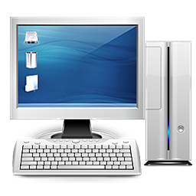
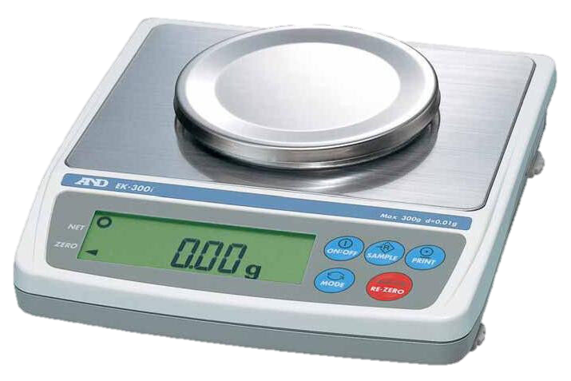
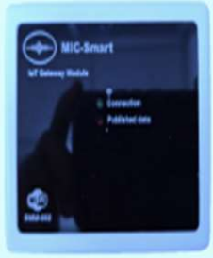
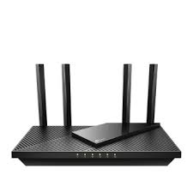






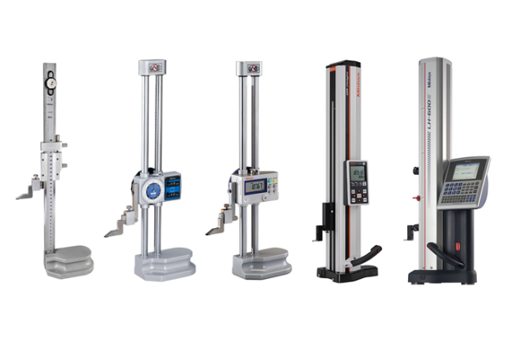

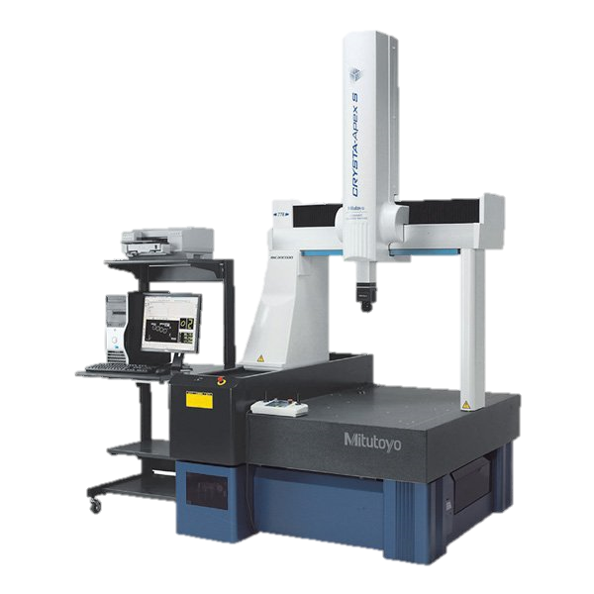



MIC IoT Measurement
1
Serial
MQTT
{
“Lot” : 001,
“Measure01” : 145
}
Ek-200i
MIC-SMART
02
Computer
2
Wi-Fi
MQTT
RS232, Lan
{
“Lot” : 001,
“Measure02” : 77.77
}
Encode
Decode
Data Base
{
“Lot” : 001,
“Measure01” : 145
}
Others
MIC-SMART
U2FsdGVkX18/zOOSalTIKLc1CkPhiNxfkFjxkAxTI87lJqu7en6i4ESMQcEpQbpNYlDKtAjeAiILKvttX4TjsA==
Server01_client
Computer
{
“Lot” : 001,
“Measure03” : 77.77,
“Spec_A” : 0.25,
“Judge” : “OK”,
}
3 3
MQTT
{
“Lot” : 001,
“Measure03” : 77.77,
“Spec_A” : 0.25,
“Judge” : “OK”,
}
Create Report
Working Room
Internet
Server Room
CMM
CSV file

Slide 2
MIC IoT Measurement
Request more Information
ลง MSSQL
ลง EXE file
Fix IP
ลง Mosquitto

